Slide 1
SOFTWARE ENGINEERING-ETCS-303
UNIT – I
Introduction:
Software Crisis, Software Processes, Software life cycle models: Waterfall, Prototype, Evolutionary and Spiral models, Overview of Quality Standards like ISO 9001, SEI-CMM.
Software Metrics:
Size Metrics like LOC, Token Count, Function Count, Design Metrics, Data Structure Metrics, Information Flow Metrics.
UNIT-II
Software Project Planning:
Cost estimation, static, Single and multivariate models, COCOMO model, Putnam Resource Allocation Model, Risk management.
Software Requirement Analysis and Specifications:
Problem Analysis, Data Flow Diagrams, Data Dictionaries, Entity-Relationship diagrams, Software Requirement and Specifications, Behavioural and non-behavioural requirements, Software Prototyping.

Slide 2
UNIT – III
Software Design:
Cohesion & Coupling, Classification of Cohesiveness & Coupling, Function Oriented Design, Object Oriented Design, User Interface Design.
Software Reliability:
Failure and Faults, Reliability Models: Basic Model, Logarithmic Poisson Model, Calendar time Component, Reliability Allocation.
UNIT – IV
Software Testing:
Software process, Functional testing: Boundary value analysis, Equivalence class testing, Decision table testing, Cause effect graphing, Structural testing: Path testing, Data flow and mutation testing, unit testing, integration and system testing, Debugging, Testing Tools & Standards.
Software Maintenance:
Management of Maintenance, Maintenance Process, Maintenance Models, Reverse Engineering, Software Reengineering, Configuration Management, Documentation.

Slide 3
TEXT BOOKS & REFRENCE BOOKS
TEXT BOOKS:
[T1] R. S. Pressman, “Software Engineering – A practitioner’s approach”, 3rd ed., McGraw Hill Int. Ed., 1992.
[T2] K.K. Aggarwal & Yogesh Singh, “Software Engineering”, New Age International, 2001
REFERENCE:
[R1] R. Fairley, “Software Engineering Concepts”, Tata McGraw Hill, 1997.
[R2] P. Jalote, “An Integrated approach to Software Engineering”, Narosa, 1991.

Slide 4
CONTENTS
Introduction: Software Crisis
Software Processes

Slide 5
Why Software Engineering ?
Change in nature & complexity of software
Concept of one “guru” is over
We all want improvement
Ready for change

Slide 6
The Evolving Role of Software
Software industry is in Crisis!

Slide 7
The Evolving Role of Software
As per the IBM report, “31%of the project get cancelled before they are completed, 53% overrun
their cost estimates by an average of 189% and for every 100 projects, there are 94 restarts”.

Slide 8
The Evolving Role of Software
Unlike Hardware
– Moore’s law: processor speed/memory capacity doubles
every two years

Slide 9
The Evolving Role of Software
Managers and Technical Persons are asked:
Why does it take so long to get the program finished?
Why are costs so high?
Why can not we find all errors before release?
Why do we have difficulty in measuring progress of software development?

Slide 10
Factors Contributing to the Software Crisis
Larger problems
• Lack of adequate training in software engineering
• Increasing skill shortage
• Low productivity improvements.

Slide 11
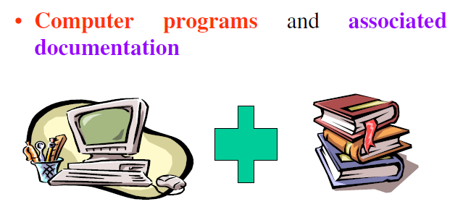
What is software?

Slide 12
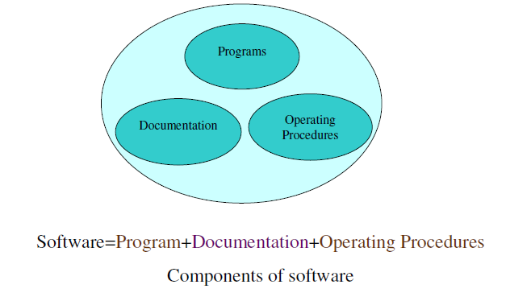

Slide 13
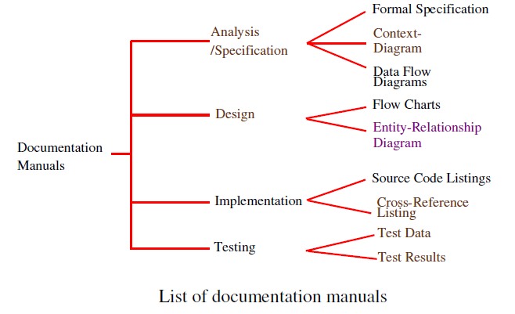
Documentation consists of different types of manuals are

Slide 14
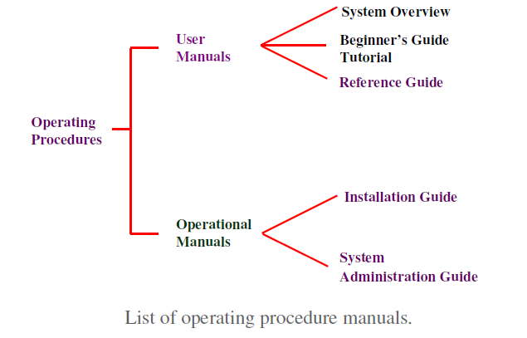
Documentation consists of different types of manuals are

Slide 15
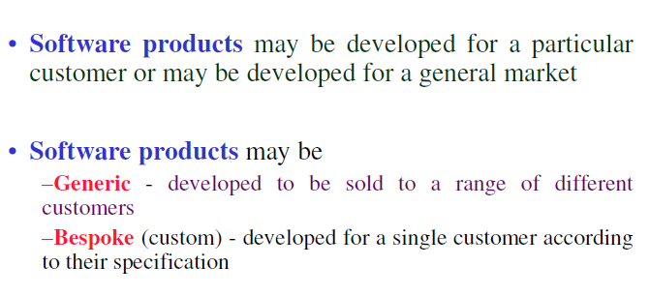
Software Product

Slide 16
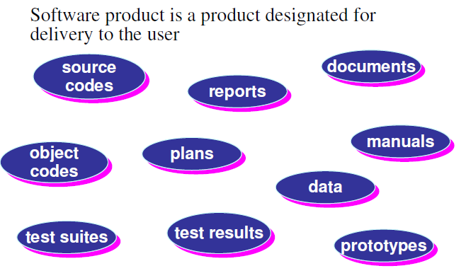

Slide 17
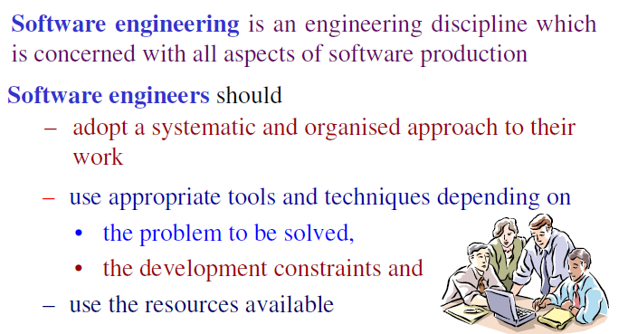
What is software engineering?

Slide 18
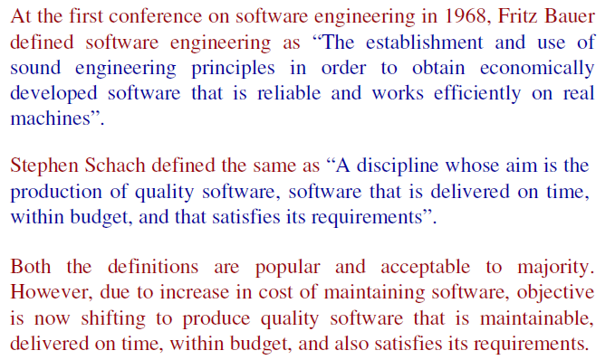

Slide 19
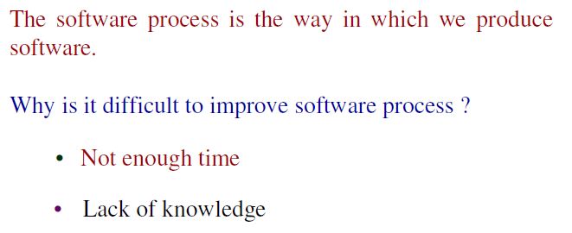
Software Process

Slide 20
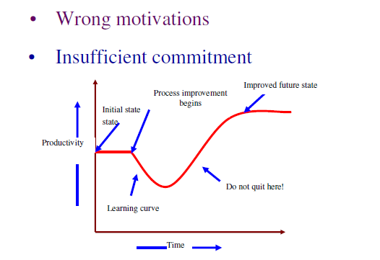

Slide 21
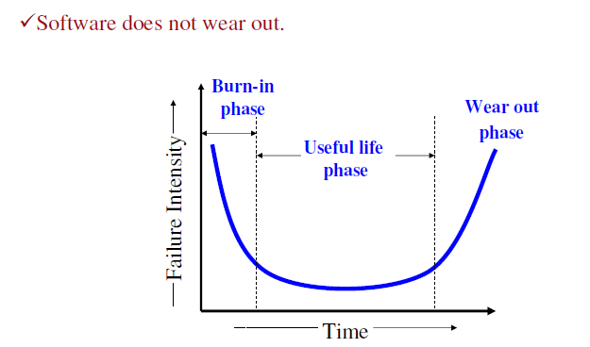
Software Characteristics:

Slide 22
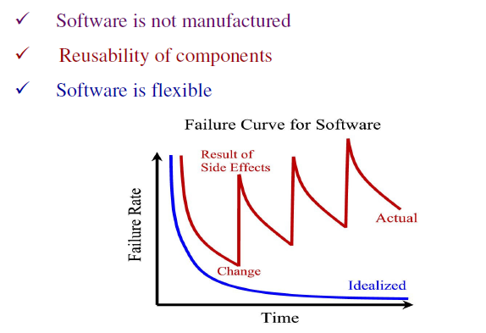

Slide 23
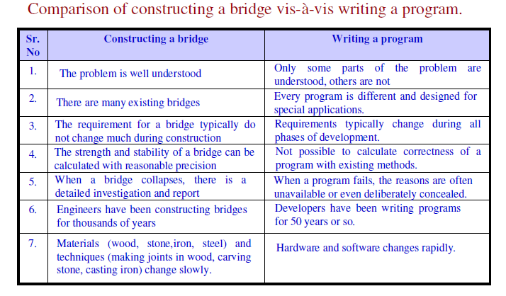

Slide 24
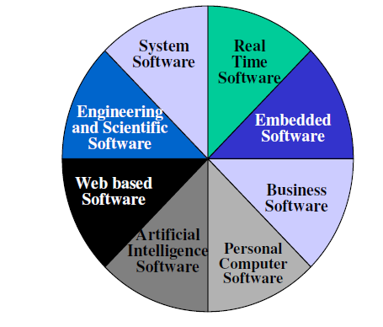
The Changing Nature of Software

Slide 25
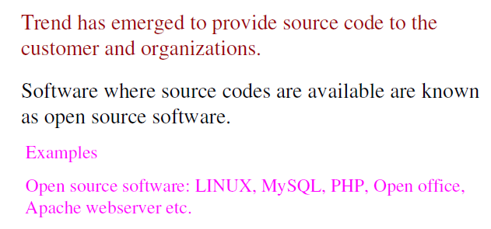

Slide 26
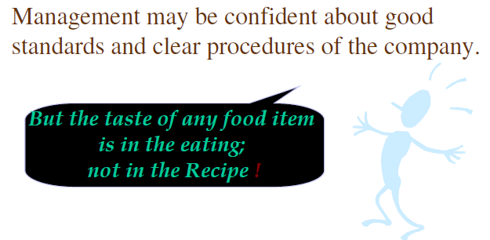
Software Myths (Management Perspectives)

Slide 27
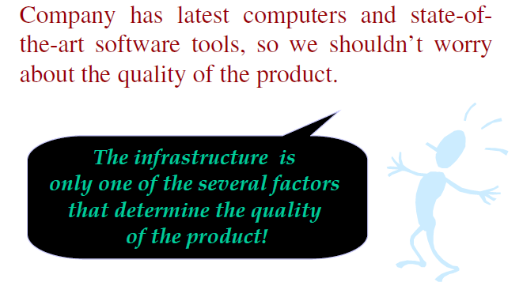
Software Myths (Management Perspectives)

Slide 28
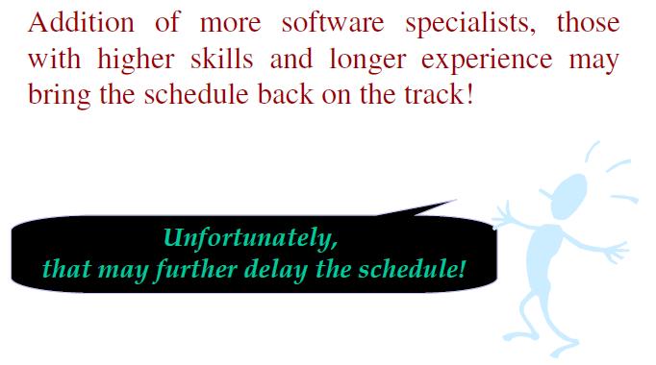
Software Myths (Management Perspectives)

Slide 29
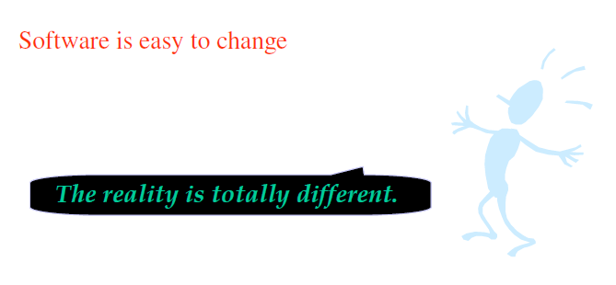
Software Myths (Management Perspectives)

Slide 30
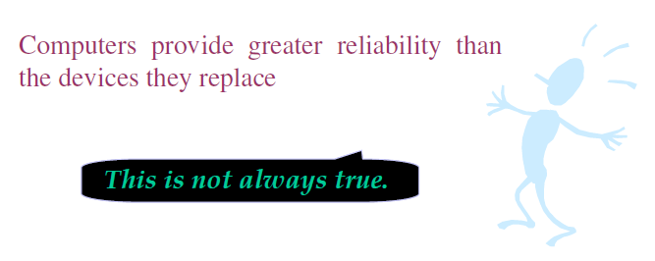
Software Myths (Management Perspectives)

Slide 31
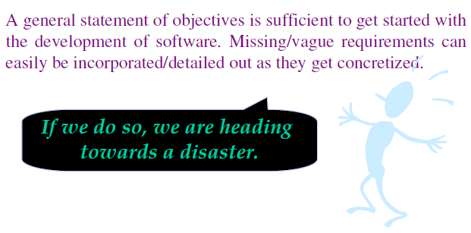
Software Myths (Customer Perspectives)

Slide 32
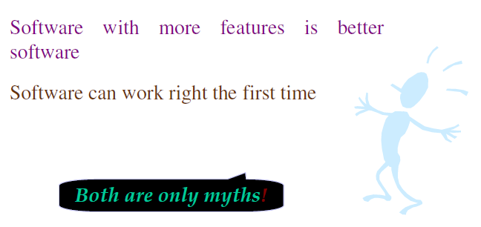
Software Myths (Customer Perspectives)

Slide 33
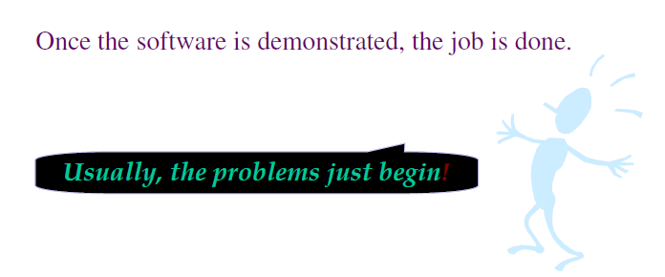
Software Myths (Developer Perspectives)

Slide 34
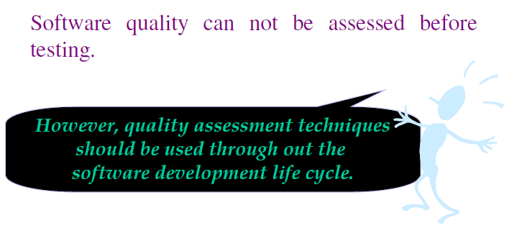
Software Myths (Developer Perspectives)

Slide 35
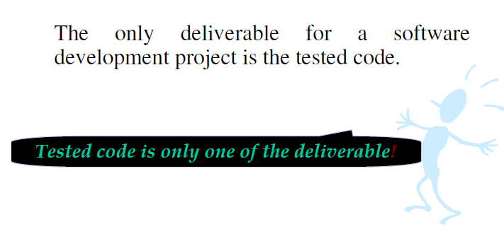
Software Myths (Developer Perspectives)

Slide 36
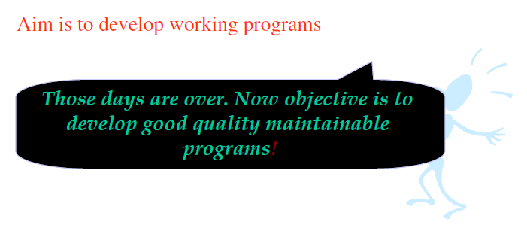
Software Myths (Developer Perspectives)

Slide 37
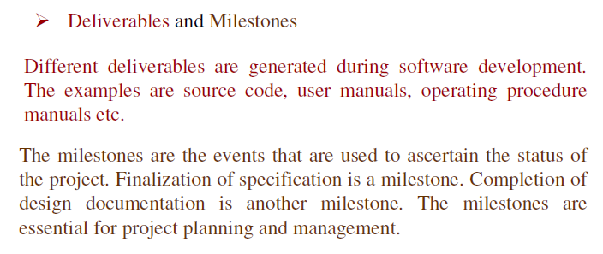
Some Terminologies

Slide 38
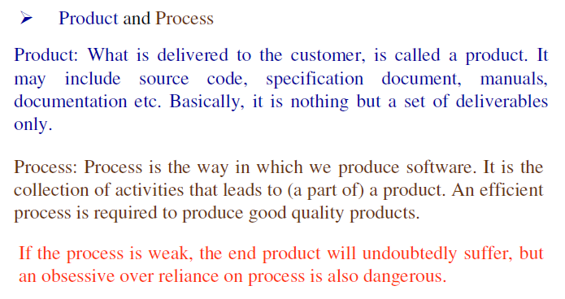

Slide 39
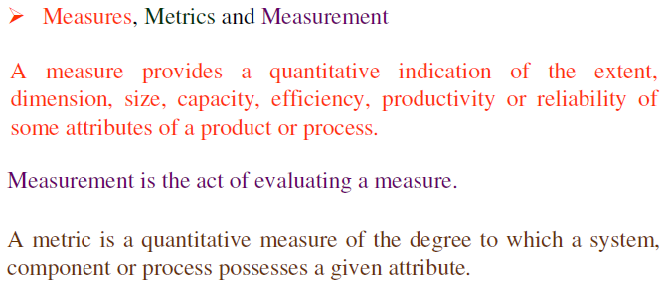

Slide 40
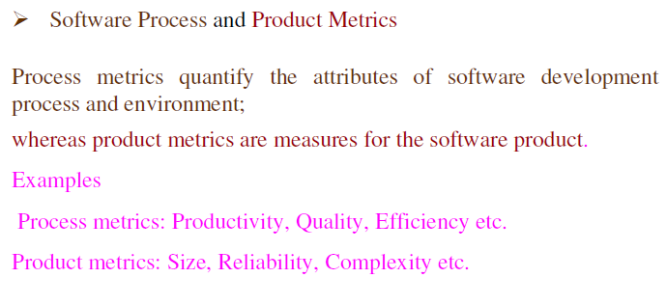

Slide 41
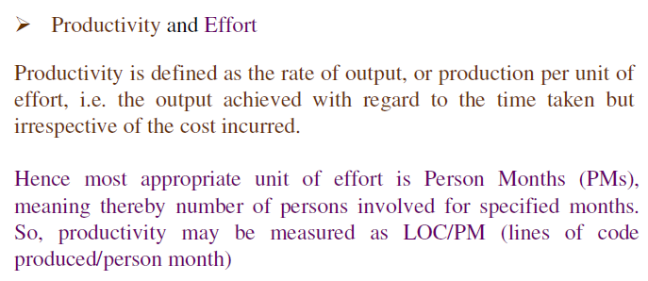

Slide 42
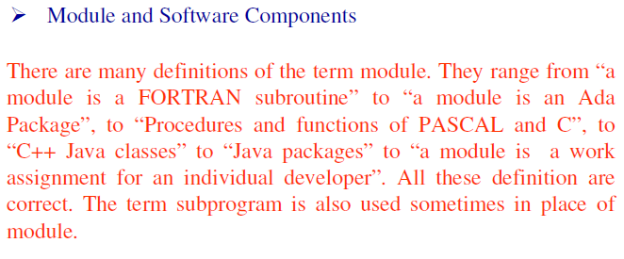

Slide 43
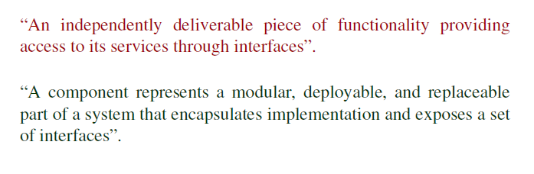

Slide 44
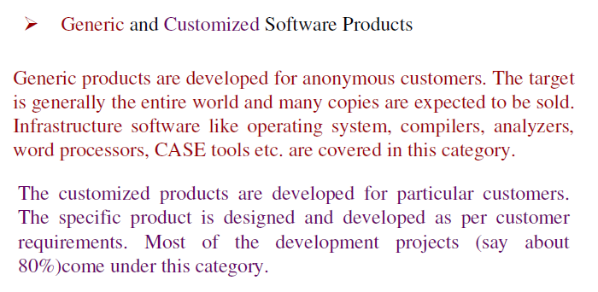

Slide 45
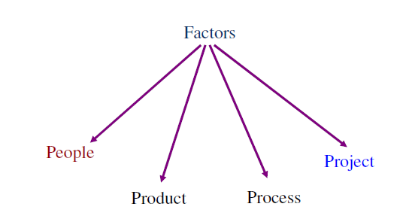
Role of Management in Software Development

Slide 46
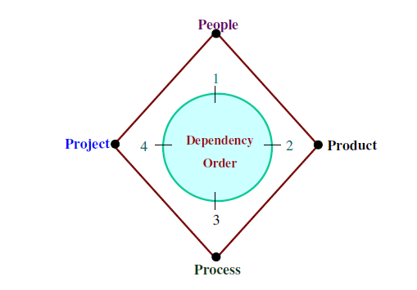
Role of Management in Software Development

Slide 47
QUESTIONS
Q-1. Software is
Superset of programs
subset of programs
(c) Set of programs
(d) none of the above
Q-2. Product is
Deliverables
User expectations
(c) Organization's effort in development
(d) none of the above

Slide 48
Q-3. During software development, which factor is most crucial?
People
Product
(c) Process
(d) Project
Q-4. Milestones are used to
know the cost of the project
know the status of the project
(c) know user expectations
(d) none of the above

Slide 49
Q-5. Software consists of
(a) Set of instructions + operating system
(b) Programs + documentation + operating procedures
(c) Programs + hardware manuals
(d) Set of programs

Slide 50
THANK YOU

